Slide 1
Volume Control Using Hand Detection

Slide 2
TEAM MEMBERS :
CHALLA JYOTHISWAR - RA1911003010914
ANNEM V S CHIDVILAS - RA1911003010898

Slide 3
PROBLEM STATEMENT:
There are many applications where hand gesture can be used for interaction with systems like, videogames, controlling UAV’s, medical equipment’s, etc.
Classical interactions tools like keyboard, mouse, touchscreen, etc. may limit the way we use the system. All these systems require physical contact, in order to interact with system.
Gestures can interpret same functionality without physically interacting with the interfacing devices.
This problem may be overthrown by the use of Deep Learning approaches. The only problem with the deep learning approaches it that they may work poorly in real world recognition. High computing power is required in order to process gestures.

Slide 4
ABSTARCT :
The Volume Control With Hand Detection OpenCV Python was developed using Python OpenCV. In this Python OpenCV Project we will be Building a Volume Controller with OpenCV , to change the volume of a computer.
Gesture recognition helps computers to understand human body language. This helps to build a more potent link between humans and machines, rather than just the basic text user interfaces or graphical user interfaces (GUIs). In this project for gesture recognition, the human body’s motions are read by computer camera.

Slide 5
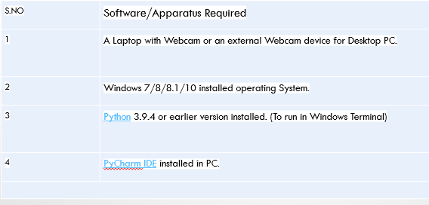
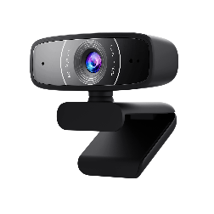



SOFTWARE/APPARATUS REQUIRED
Fig.1 Webcam
Fig.2 Windows OS
Fig.3 Python
Fig.4 PyCharm

Slide 6
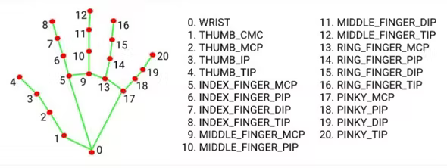
OBJECTIVE :
The objective of this project is to develop an interface which will capture human hand gesture dynamically and will control the volume level. For this, Deep Learning techniques such as Yolo model, Inception Net model+ LSTM, 3-D CNN+LSTM and Time Distributed CNN+LSTM have been studied to compare the results of hand detection.

Slide 7
ISSUES IN EXISTING PROJECT :
Can't be used for long distance
Sometimes not accurate
Requires a decent camera
May be confused by two palms

Slide 8
PROPOSED METHODOLOGY :
Detect hand landmarks
Calculate the distance between thumb tip and index finger tip.
Map the distance of thumb tip and index finger tip with volume range. For my case, distance between thumb tip and index finger tip was within the range of 1 cm – 10 cm and the volume range was from 15 – 100.
In order to exit press ‘Spacebar'.

Slide 9
System Flow Diagram :
Capture
Object detection
Hand detection
Gesture control
Feature extraction

Slide 10
WORKING PRINCIPLE :
The camera in our device is used for this project.
It detects our hand with points in it.
So as it can see the distance between our thumb fingertip and index finger tip.
The distance between the points 4 and 8 is directly proportional to the volume of device.
Following are the Libraries of Python Language.
1.OpenCV 2.Media Pipe 3.Numpy etc..

Slide 11
We have to import and install some Libraries to run this program:
import cv2
import mediapipe as mp
from math import hypot
from ctypes import cast, POINTER
from comtypes import CLSCTX_ALL
from pycaw.pycaw import AudioUtilities, IAudioEndpointVolume
import numpy as np

Slide 12
Following are the Libraries/Interpreter of Python Language: -
OpenCV- OpenCV is a cross-platform library using which we can develop real-time computer vision applications. It mainly focuses on image processing, video capture and analysis including features like face detection and object detection.
MediaPipe: - MediaPipe is a cross-platform framework for building multimodal applied machine learning pipelines. MediaPipe is a framework for building multimodal (eg. video, audio, any time series data), cross platform (i.e Android, iOS, web, edge devices) applied ML pipelines.
NumPy: - NumPy is a basic level external library in Python used for complex mathematical operations. NumPy overcomes slower executions with the use of multi-dimensional array objects.

Slide 13
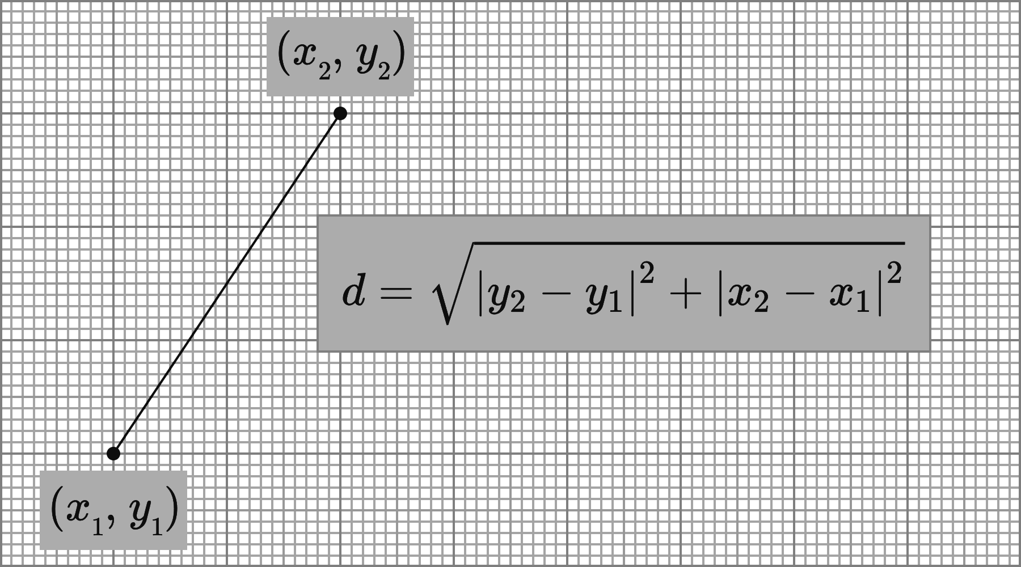
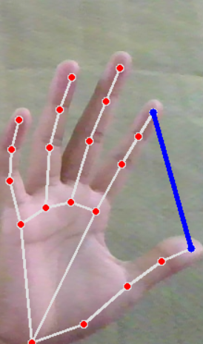
LENGTH CALCULATION BETWEEN TWO FINGER TIP POINTS

Slide 14
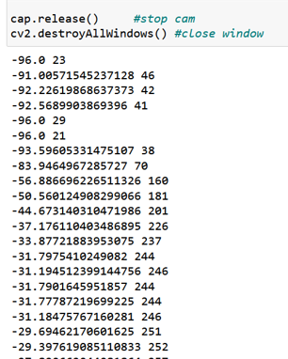
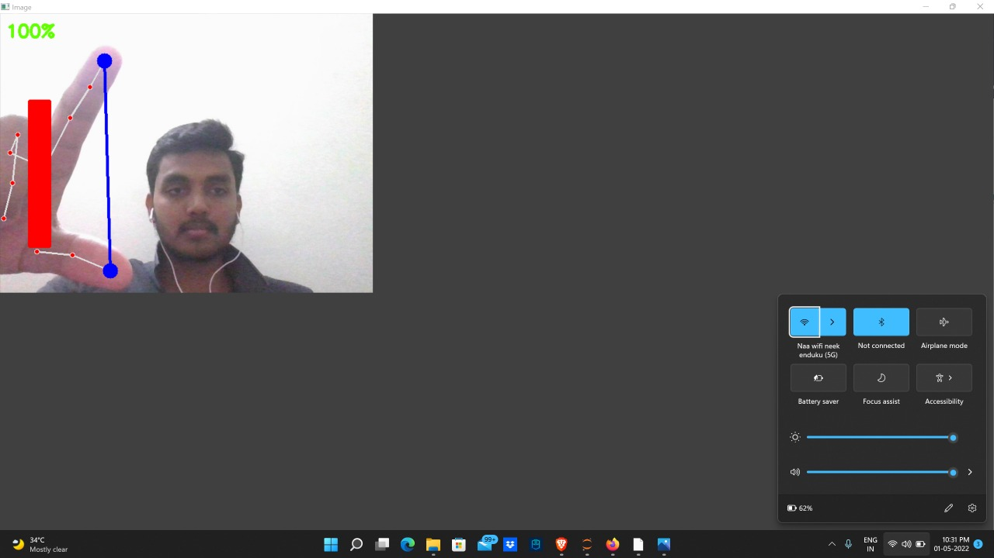
RESULT AND OUTPUT DISCUSSION
After running the project, you will get output interface like this

Slide 15
Purpose of the problem statement (societal benefit)
Gesture recognition helps computers to understand human body language.
This helps to build a more potent link between humans and machines, rather than just the basic text user interfaces or graphical user interfaces (GUIs).
In this project for gesture recognition, the human body’s motions are read by computer camera. The computer then makes use of this data as input to handle applications.

Slide 16
CONCLUSION :
Gesture recognition helps computers to understand human body language. This helps to build a more potent link between humans and machines, rather than just the basic text user interfaces or graphical user interfaces (GUIs).
In this project for gesture recognition, the human body’s motions are read by computer camera. The computer then makes use of this data as input to handle applications.

